Slide 1
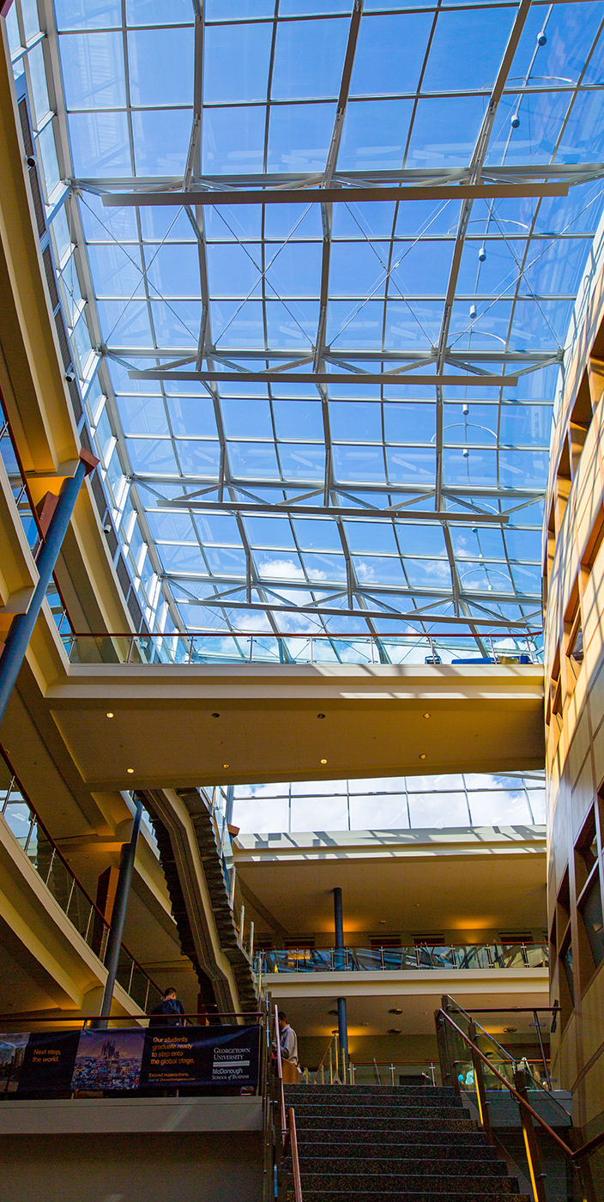

FINC 6580 Fintech
LiveSession 2
Notes:
[Text for introducing the content for this week at a high level.]

Slide 2

Need a chat master….
Need help monitoring the chat window…

Slide 3
TURN ON RECORDING!!!!!!!!!!!!!!

Slide 4
Request : Put section and team # in screen name.

Slide 5

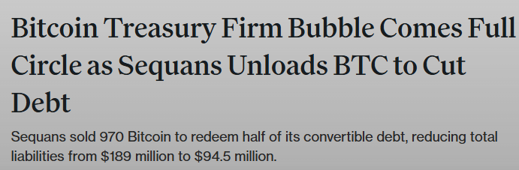

Slide 6
Fintech: Election markets
Betting on elections was widespread 19th and early 20th century
  Public opinion tide turned against gambling
  Gambling illegal in most of US in early 20th century
  Gradually legalized in late 20th, early 21st.
Tide is turning…
  Courts now allow election markets
  Kalshi launches prediction markets as CFTC registered futures contracts
  Polymarket on the crypto side, soon to be CFTC registered futures markets.

Slide 7
But first….
You tell me: What were the main things you learned this week in this class?

Slide 8
For tonight…
1. In the news
2. Presentations: Deliverable #1

Slide 9

Good night! !

